Slide 1
Web Application Development II
Week 4: Vue.js
Building reactive, interactive pages

Slide 2

Agenda
DOM Manipulation
Introduction to Vue
Installation and setup
Vue.js Features
Data/Attribute/Form Input binding
Class & Style binding
Routing

Slide 3
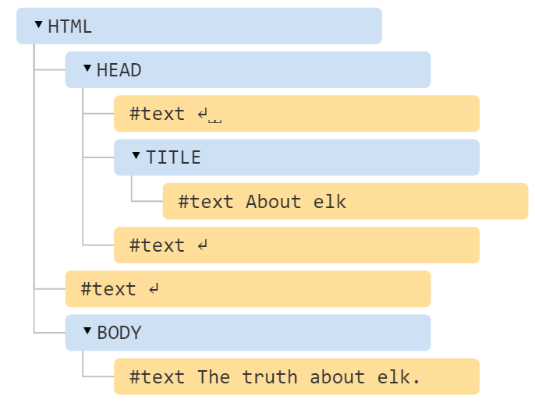
What is DOM?
<!DOCTYPE HTML>
<html>
<head>
<title>About elk</title>
</head>
<body>
The truth about elk.
</body>
</html>
The browser represents an HTML document as Document Object Model (DOM).
In DOM, every HTML entities – elements, attributes, texts are represented as nodes (objects) in a hierarchical data structure.
This data structure makes it easy for JavaScript to access and change the entities in an HTML document.
Document Object Model (DOM) - Web APIs | MDN
With DOM, we can access and modify the HTML document through Javascript.

Slide 4
DOM Manipulation
Manipulating the DOM, we can create dynamic web pages
change all the HTML elements, attributes, and CSS styles in the page
change all the HTML elements, attributes, and CSS styles in the page
remove existing HTML elements and attributes
add new HTML elements and attributes
react to HTML events in the page
create new HTML events in the page
You can do whatever you want to the tree.

Slide 5
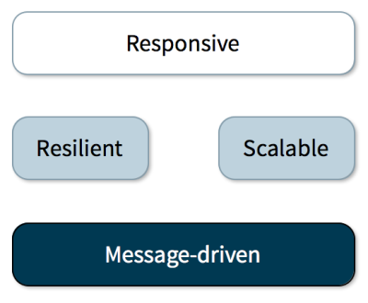
What is a Reactive Application?
A reactive web application
Observe changes in application state
Propagate change notification throughout the application
Render views automatically in response to changes in state
Provide timely feedback for user interactions
💡 Analogy: Think of a spreadsheet — change one cell and every formula that depends on it updates instantly. Vue works the same way: when a ref changes, every part of the template that uses it re-renders automatically.

Slide 6
What is Vue.js
Vue (pronounced like View) is a progressive framework for building user interfaces.
The core library is focused on the view layer only, and is easy to pick up and integrate with other libraries or existing projects.
On the other hand, Vue is also perfectly capable of powering sophisticated Single-Page Applications when used in combination with modern tooling and supporting libraries.
Example
Themes
⚠ This course uses the Composition API with <script setup> — NOT the Options API. When reading vue.js docs at vuejs.org, always switch the toggle to "Composition API".

Slide 7



Why Vue.js
Used by Alibaba
Google
Facebook

Slide 8
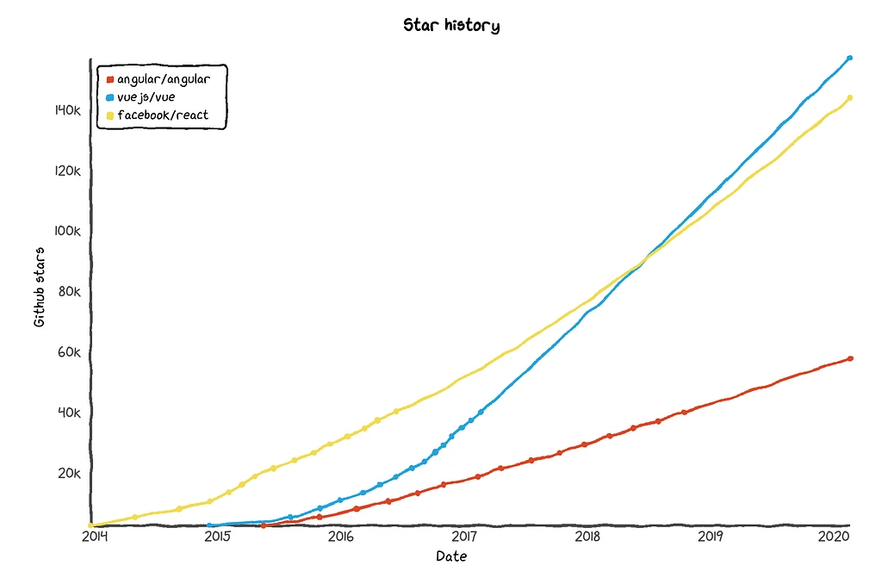
Why Vue.js
Popularity: Read Here
“React has been a leader in popularity among JavaScript frameworks. It takes the first place with the number of 48,718 dependents, whereas, Vue.js is the second most popular JavaScript framework with half as many dependents — 21,575, as reported by Node Package Manager. Though, if we take a look at statistics at the end of 2018, we will see that Vue’s dependents had tripled, while React’s had doubled.”
Extremely small (16KB)
Great runtime performance
Easy to learn

Slide 9
Vue.js Features
Data Binding: This feature helps manipulate or assign values to HTML attributes, change the style, assign classes with the help of binding directive called v-bind
Directives: built-in directives such as v-if, v-else, v-on, v-bind, and v-model, which are used to perform various actions on the frontend.
Event Handling: with v-on directive, it can listen to the events
Computed Properties: helps to listen to the changes made to the UI elements and performs necessary calculations
Components: custom elements that can be reused in HTML

Slide 10
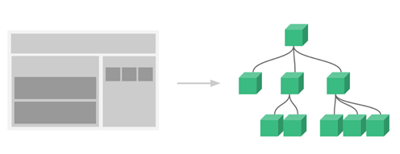
Vue Components
Vue components are an abstraction that allows us to build large-scale applications composed of small, self-contained, and often reusable components.
A component is a group of elements (i.e., template) together with the Vue instances with a name so that it can be reused.
In a large application, it is necessary to divide the whole app into components to make development manageable and scalable.
Example
<div id="app">
<app-nav></app-nav>
<app-view>
<app-sidebar></app-sidebar>
<app-content></app-content>
</app-view>
</div>
Vue components allow you to define your own reactive tags.

Slide 11
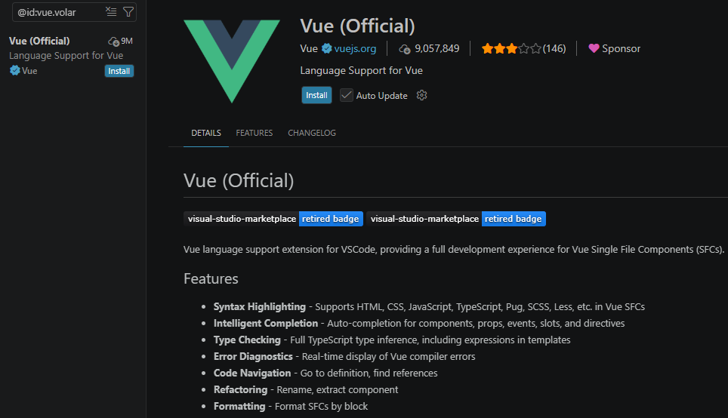
Vue – Official Extension for VS Code
Search for Vue (Official) or vue.volar in the VSCode extension and click install:

Slide 12
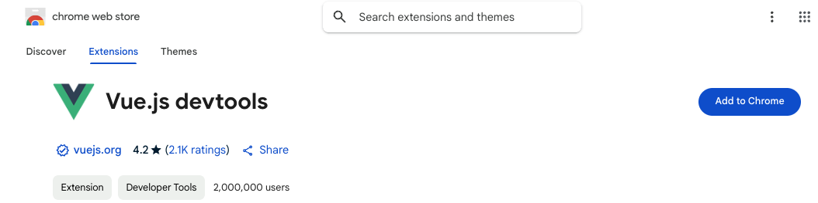
Vue.js devtools for Chrome
Install Vue.js devtools for chrome:

Slide 13

Install Node.js
Download and install Node.js: https://nodejs.org/en
After Node.js is installed, open the terminal and run the command:
node -v
If the version appears, it means node was successfully installed
Ensure that node version >= 22.12.0
Note: Node.js comes with NPM, which is a software package manager. NPM is needed to install pnpm, Vue CLI and other packages …

Slide 14
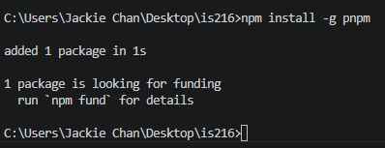

Install pnpm
pnpm (Performant npm) is a fast, highly efficient JavaScript package manager designed as a drop-in replacement for npm and Yarn. It solves disk-bloat and slow installations by using a global, content-addressable storage to share packages across all projects, linking them via hard links and symlinks
Open your terminal (Command Prompt, PowerShell, or Mac terminal) and run:
npm install -g pnpm
Check if it was successfully installed:
pnpm -v

Slide 15
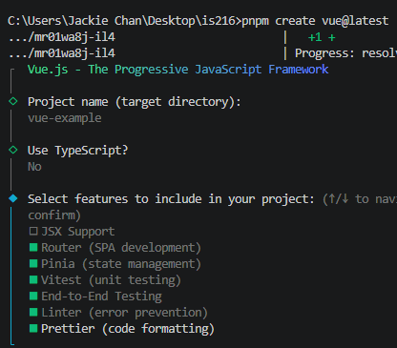
Quick Start (1)
Let’s create a Vue app.
In the terminal, run
pnpm create vue@latest
Project name -> vue-example
Use TypeScript? No
Select features -> press spacebar to select:
Router, Pinia, Vitest, End-to-End Testing, Linter, Prettier
Press Enter
follow this guide for detail

Slide 16
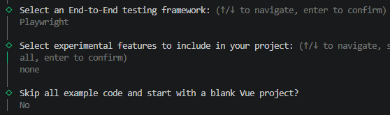
Quick Start (2)
Select an End-to-End testing framework: Playwright
Select experimental features … : none
Skip all example code … ? No

Slide 17
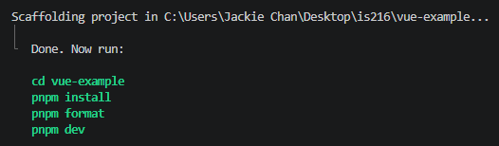
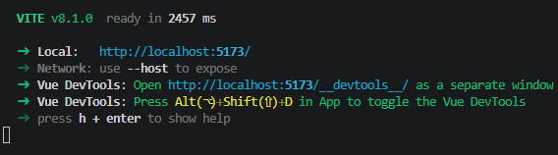
Quick Start (3)
Vue project should be created in your workspace.
Run the following commands (one by one):
cd vue-example
pnpm install
pnpm format
pnpm dev
After running the above commands, vue app is deployed. Click on this link to view the app in the browser
Note: the link with “/___devtools__/” will open the Vue dev console (for debugging purposes).
To stop the server, press Ctrl + c
To start again, run the command pnpm dev

Slide 18
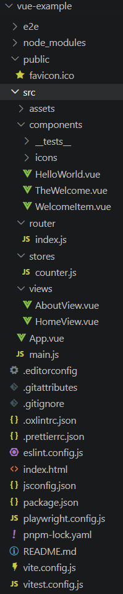
Structure of a Vue App (1)
node_modules/: stores all external libraries and dependencies your project needs to function. This is auto-generated by your package manager and shouldn't be edited directly
public/: stores static assets like favicon.ico
src/: The heart of your application. This contains:
assets/: files that need to be processed by your bundler, such as raw CSS/SCSS files, fonts, and images.
components/: contains modular, reusable pieces of your UI components (e.g., headers, footers, navigation bars, and cards).
router/: contains routing configuration (index.js) that maps URL paths to specific views.
stores/: holds state management logic (using Pinia) for centralized data sharing across your SPA.
views/ (or pages/): Contains components that represent full pages or major UI sections, typically mapped to routing paths (e.g., Home.vue, About.vue).
Additionally you may create utils/ (or helpers/) folder to store miscellaneous helper functions, such as date formatters or math calculators, used throughout the app

Slide 19
Structure of a Vue App (2)
index.html: the landing page of your web app. It is also the only .html page (Single Page App). Notice that it
contains <div> element with id “app”. This is where all the contents (Vue components) will be loaded
imports “main.js” file
main.js: imports libraries and Vue components; initialize Vue app instance (App.vue) and attaches it to the DOM (<div id=‘app’></div>) in index.html
App.vue: the master/root component. All other components are typically nested inside this single-file component.

Slide 20
Structure of a Vue App (3)
Following are configuration files that we don’t usually need to bother with:
package.json: lists your project dependencies, scripts, and version metadata
vite.config.js: bundler configuration file that lets you define plugins, proxies, and build optimizations.
vitest.config.ts: configuration file for Vitest, a fast, Vite-native testing framework for Vue. It defines how your unit and component tests are configured, executed, and integrated into your build pipeline. Note: *.ts denotes a typescript file, which is a typed, compiled language built on top of JavaScript.
playwright.config.js: configuration file for Playwright, a powerful end-to-end (E2E) testing framework. Unlike unit tests that check small pieces of code, E2E tests launch real browsers to simulate actual user journeys—like logging in, clicking buttons, and completing checkouts. This file controls exactly how those browsers behave and how your tests execute.
vue.spec.js: boilerplate, starter test file auto-generated when you scaffold a Vue app using tools like Vite with End-to-End (E2E) testing selected

Slide 21
Routing (1)
Routing on the server side means the server is sending a response based on the URL path that the user is visiting. When we click on a link in a server-rendered web app (e.g., Express.js + MVC + ejs template engine), the browser receives an HTML response from the server and reloads the entire page with the new HTML.
Routing on the client side means the client side app (e.g., Vue’s Single-Page Application) can intercept the navigation, dynamically fetch new data, and update the current page (typically with a new Vue component), without full page reloads.
In Vue’s Single-Page Application (SPA), this is done by using Vue Router.

Slide 22
Routing (2)
Vue Router is a Vue Library that provides two components: RouterLink and RouterView.
RouterLink is used to create links (Instead of using regular <a> tags)
RouterView component tells Vue Router (the location) where to render the current route component.
Syntax
<RouterView /> <RouterLink to=<path> > Label </RouterLink>
<template>
<RouterView />
</template>
<template>
<RouterLink to="/">Go to Home</RouterLink>
<RouterLink to="/about">Go to About</RouterLink>
</template>

Slide 23
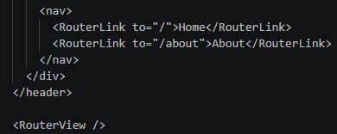
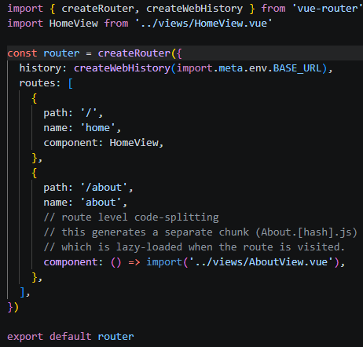
Routing (3)
Check out App.vue and router/index.js in the example app that we created based on the Quick Start slides
App.vue provides a default template which use <RouterView />
This will link to router/index.js
In App.vue or any other component nested in App.vue, use <RouterLink></RouterLink> to map the URL to the specific Vue components. For example,
“http://localhost:5173/about” maps to “AboutView.vue” component, which will be rendered in the <RouterView /> location in App.vue
App.vue
router/index.js

Slide 24
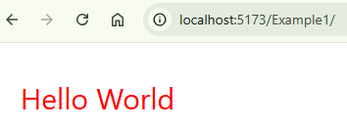
Hello World
Check out Example1.vue component in given example folder
Example: Example1.vue
In the terminal, go to the example folder and run
pnpm dev
Click on the localhost link
In the browser, click on “Example1” and observe the output

Slide 25
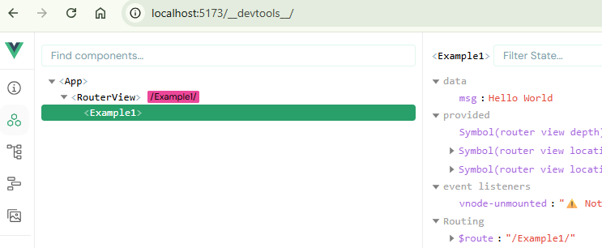
DevTools
Open the devtools by clicking the link with /__devtools__/
Click on the buttons in the left panel and explore
Example: Example1.vue

Slide 26
Component: Syntax
Components contain 3 things. Yes you guessed them right. They are JavaScript, HTML, and CSS ☺
<script setup> ** Vue/JS stuff ** </script>
<template>** HTML stuff ** </template>
<style scoped>** CSS stuff ** </style>
Note: “scoped” means the styling is applicable only to this particular component.
⚠ We use the Composition API (<script setup>). Vue docs show both APIs — always select "Composition API" in the toggle when reading documentation.
✓ Memory aid: <script setup> = JS logic | <template> = HTML | <style scoped> = CSS

Slide 27
Component: Syntax
Example: Example2.vue
// import libraries
import { ref } from ‘vue’
// define data
const name = ref(“John”)
const phone = ref(123456)
// use data
console.log(name.value)
// define method(s)
function getPhone() {
// method doesn't necessarily 'return’
return "This is my number " + phone.value
}
ref: Vue’s library function used to create reactive variables. It takes the argument and returns it wrapped within a ref object with a .value property
Other Vue libraries that are typically imported include:
onMounted, computed, defineProps, defineEmits, …
Note: for objects, reactive, instead of ref, can also be used.But we shall cover this function in this course.
For more info: https://vuejs.org/guide/essentials/reactivity-fundamentals.html#reactive
⚠ ref() is a Composition API function. In Vue docs, always read the "Composition API" tab — not Options API (which uses data: {} and methods: {} instead of ref()).

Slide 28
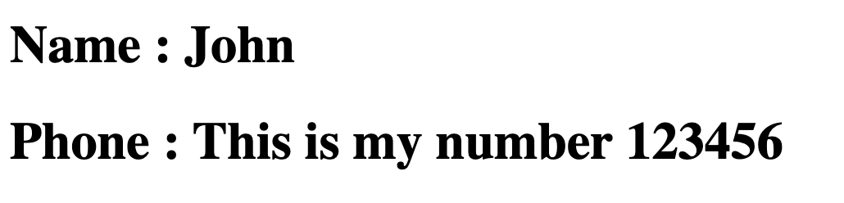
Data Binding (1)
The most basic form of data binding is text interpolation using the “Mustache” syntax (double curly braces):
{{ … }} tells Vue to take everything inside them and parse it as code.
Example: Example2.vue
<h1> Name : {{name}} </h1>
<h1> Phone : {{getPhone()}} </h1>
In the above example, name will be replaced with the value of the name property of the vue instance.
getPhone() will be replaced with the outcome of the invocation of vue instance’s getPhone method.
✓ Rule: {{ }} only works INSIDE the template between tags (e.g. <p>{{ name }}</p>). It cannot be used inside HTML attributes — use v-bind (:) instead (e.g. :src="imgUrl").

Slide 29
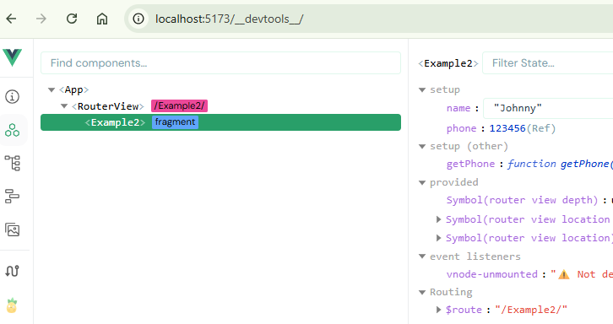
Data Binding (2)
The value inside {{ … }} will be updated whenever there is a change in property.
Experiment:
In devtools, select Example2 component
Change name property to “Johnny”
Observe that the page is updated automatically

Slide 30
Vue Debugging 101
Use Chrome console and devtools to debug
Enter variable names and check if you get expected results
If you run into something you can’t figure out, or you find a particularly nasty error, check out https://forum.vuejs.org/c/help
Two common issues
Symptom: “Uncaught SyntaxError: Unexpected identifier”
Illness: usually typo error, missing comma or braces, or hidden strange characters
Symptom: “[Vue warn]: Property or method "propertyname" is not defined”
Illness: something was not defined in the options object (property or method)

Slide 31

Exercise 1
In Ex1.vue, the HTML part of the page is given. Program the script part by so that the page looks like the following.
Note: you need to install/include the node_modules first. In the terminal,
cd resource
pnpm dev

Slide 32
Vue Directives
v-bind | Bind an attribute value with a vue variable | <img v-bind:src="myImg" />
v-html | Print a given vue variable as HTML | <div v-html="message"></div>
v-on | Listen to DOM events and run code | <button v-on:click=”msg = ‘hello’ ">Add</button>
v-for | Loop through items in a Vue parameter – list (items) | <ul><li v-for="item in items"> </li></ul>
v-if v-else | Remove/insert an element based on the truth value of Vue parameter | <div v-if="seen">You either see this</div> <div v-else>or this!</div>
v-model | Bind Vue parameters to the values of input elements such as text, radio, and checkbox | <input v-model="msg"> <select v-model=“option”>
Directives are special attributes with the v-prefix, used to reactively apply side effects to the DOM when the value of its expression changes.
Notes:
Using v-if and v-for together is not recommended.
see: https://v3.vuejs.org/guide/conditional.html#v-show

Slide 33
Conditional Rendering (1)
The directive v-if, v-else is used to conditionally render a block. The block will only be rendered if the directive's expression returns a truthy value.
A v-else element must immediately follow a v-if or a v-else-if element - otherwise it will not be recognized.
*explore v-else-if on your own
Example: Example3.vue
<p v-if="x==1">Now you see me</p>
<p v-else>You don’t see me</p>
Here, the v-if directive would remove/insert the different <p> element based on the truthiness of the expression x==1.
Note that x should be a reactive variable.
Directive attribute values are expected to be a single JavaScript expression.
💡 v-if vs v-show: v-if removes/inserts the element from the DOM entirely. v-show keeps it in the DOM but toggles CSS display (lighter for frequent toggling).

Slide 34
Conditional Rendering (2)
To toggle more than one element, we can use v-if on a <template> element, which serves as an invisible wrapper.
The final rendered result will not include the <template> element.
Example: Example4.vue
<template v-if="ok">
<h1>Title</h1>
<p>Paragraph 1</p>
<p>Paragraph 2</p>
</template>

Slide 35
Attribute Binding (1)
The value of HTML attributes, e.g., id, value, src, href, …, can be bound to the Vue component’s property
Note: Mustaches {{ … }} cannot be used for binding inside HTML attributes. Use v-bind directive, instead.
Example: Example5.vue
<img src="/abc.png" v-bind:width="x">
This directive instructs Vue to keep the image element’s width attribute in sync with the component's property x.
Shorthand
<img src="/abc.png" :width="x">
💡 Why not {{ }}? Writing src='{{ imgUrl }}' gives a literal string — Vue won't treat it as dynamic. :src="imgUrl" tells Vue to evaluate imgUrl as a reactive expression and keep the attribute in sync.

Slide 36


Importing an image
You can place static assets like images or text files in /public folder or /src/assets folder
Import and use these assets: Example5.vue
<script setup>
import { ref } from 'vue’
import wad from '/assets/wad.png' // public/assets/ folder
const me = ref('/src/assets/me.png') // src/assets/ folder
</script>
<template>
<img v-bind:src="wad"><hr>
<img v-bind:src="me"><hr>
</template>

Slide 37
Static assets in src/assets vs public folders
Both src/assets and public folder can store static assets like images and text files but there are some differences:
 | src/assets | public
referencing | Referenced via relative paths, e.g., <img src=‘../assets/logo.png’> | Referenced relative to the web root, e.g.., <img src=‘/logo.png’>
Build process | Compiled, optimized, and minified by the bundler | Copied as-is to the output directory, e.g., dist
Dead code elimination | Unused assets are excluded from the final build | All files are included in the build

Slide 38
Attribute Binding (2)
You can also bind multiple attributes using an object
Example
const obj = {
src: ‘x’,
width: ‘y’,
}
===
<img v-bind=“obj” >
💡 Shorthand tip: v-bind="obj" (without a colon or attribute name) spreads ALL keys of the object as HTML attributes. Handy when the same set of attributes is reused across multiple elements.

Slide 39

Exercise 2
In Ex2.vue, the script part is given. Complete the HTML part such that the image is displayed with data defined in the script part.
Use the given ‘width’ and ‘height’ properties to set the image width and height. Try using both single attribute binding and multiple attribute binding

Slide 40
Attribute Binding (3)
Boolean attributes are attributes that can indicate true / false values by their presence on an element.
For example, disabled is a common Boolean attribute:
Example: Example6.vue
const isButtonDisabled = ref(true)
===
<button :disabled="isButtonDisabled">Button</button>

Slide 41
Form Input Binding
Use v-model to create two-way data bindings on form input, textarea, and select elements.
Example: Example7.vue
const username = ref(‘’)
===
Name: <input type=‘text’ v-model=‘username’ >
Your name is {{ username }}
Fyi (non-examinable) : v-model may use different properties and emits different events for different input elements.
text and textarea elements use value property and input event;
checkboxes and radio buttons use value (or checked property if value is not defined) and change event;
select fields use value as a prop and change as an event.
💡 Two-way means both directions: (1) user types → username.value updates | (2) you set username.value in code → the input field text updates. Compare: :value only does direction 1 (one-way).

Slide 42
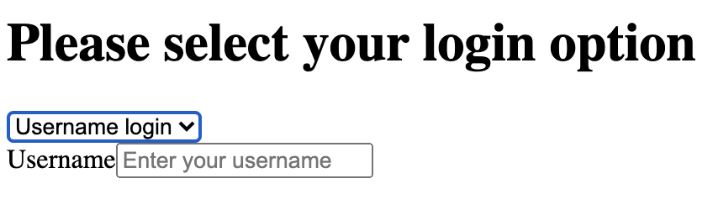
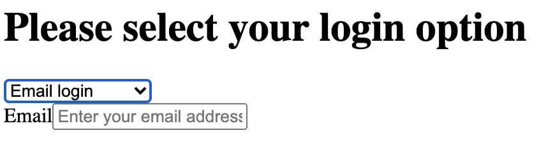
Exercise 3
In Ex3.vue, a dropdown list is provided to allow users to login with either username or email. Render the page different depending on the selection, i.e., show an input for an email or a username accordingly.
Hint: use v-model, v-if, and v-else to accomplish the task.

Slide 43
Class and Style Binding (1)
A common need for data binding is manipulating an element’s class and its inline styles, to control CSS
Use v-bind to bind class and style attributes
Syntax:
v-bind:class="{'className' : isActive}”
v-bind:class = ”[prop1, prop2]"
v-bind:style="{‘css-property’ : prop}"
Example: Example8.vue and Example9.vue
Notice the CSS code written in <style scoped> in Example8.vue (internal styling) and the absence of it in Example9.vue
💡 Reading { 'active': isActive }: 'active' is the CSS class name (key) and isActive is the condition (value). Vue applies the class when the condition is true, removes it when false.

Slide 44
Class and Style Binding (2)
Binding to Objects
We can pass an object to :class to dynamically toggle classes:
<div v-bind:class="{'className' : isActive}”></div>
You can have multiple classes:
<div
class="static"
:class="{ ‘demo’: isActive, 'text-danger': hasError }"
></div>
Example: Example8.vue
Don’t forget the quotes.
isActive and hasError are the Vue component’s properties

Slide 45
Class and Style Binding (3)
Binding to Arrays
We can pass an array to :class to apply a list of classes:
Example: Example8.vue
const activeClass = ref('active')
const errorClass = ref('text-danger’)
===
<div :class="[activeClass, errorClass]"></div>

Slide 46
Class and Style Binding (4)
Binding Inline Styles
Similar to class attribute, we can also bind to style attribute with an object
Example: Example9.vue
const activeColor = ref('red')
const fontSize = ref(30)
===
<div :style="{
color: activeColor,
fontSize: fontSize + 'px’
}">
</div>
⚠ Common mistake — camelCase required: CSS uses hyphens (font-size, background-color) but in a JS style object, use camelCase: fontSize, backgroundColor. Writing 'font-size' works too but requires quotes: { 'font-size': fontSize }.

Slide 47




Exercise 4
Part 1:
Add code in Ex4.vue such that when you click “Change Color”, it changes to red from blue or to blue for red alternately.
Part 2:
Add code in Ex4.vue such that when you click “Change Text Color”, it changes to red from blue or to blue for red alternately.
Use v-bind with class and style bindings
Challenge: you will notice that your buttons does not have colors. Debug!!!

Slide 48
Routing: with Parameter
In the routes, we can pass a parameter.
For example,
{path: "/products/:id", component: ”ProductsView" }
When the user visits the path, e.g., http://localhost:5173/products/1, the router launches ProductsView component, passing it the parameter id with the value of 1
That is, in ProductsView component, the parameter can be accessed via route.params.xx
Example Example10.vue
import { useRoute } from 'vue-router’
// 1. Initialize the route hook
const route = useRoute()
// 2. Read the parameter (Note: route params are always strings)
const productId = route.params.id
⚠ Gotcha: route.params always returns a string. If you need a number (e.g. to look up an array), convert it: parseInt(route.params.id). Comparing 1 === '1' is false in JavaScript!

Slide 49
Routing: Redirect (1)
In routing, we can redirect a given URL to another URL.
For example,
{ path: "/invalid", redirect: "/Example1" }
When the user visits an invalid URL /invalid (e.g., http://localhost:5173/invalid), the router automatically redirects to /Example1
Use case:
Redirect to a default landing page when the user visits the site
Redirect to a login page after user registration
Example router/index.js

Slide 50
Routing: Redirect (2)
Redirect can also be implemented programmatically using router.push(/new_url)
When router.push executes, Vue Router changes the browser's current address path to /new_url and loads the component mapped to that route.
Example Example11.vue
import { useRouter } from "vue-router"
const router = useRouter()
function logout() {
… // logout logic
router.push("/Example1");
}
After log out, redirect to /products
💡 When to use router.push vs RouterLink: Use RouterLink for static nav menus. Use router.push() when navigation happens after an action — form submit, login success, delete confirmation, etc. Same result, different trigger.

Slide 51
Take Away Message
With vanilla Javascript, you will constantly go from HTML to Script and back (via DOM, search from the root of the DOM tree, using document.getElement...).
With Vue.js, you declare the connection between HTML and Script and focus more on the logic in Vue.
Put it simply: no more document.getElement...

